Slide 1

International Retailer Exploratory Data Analysis
Antonella Convertini Valeria Riccardo Alexander Dudakov Andreas Casini Timur Rezepov

Slide 2
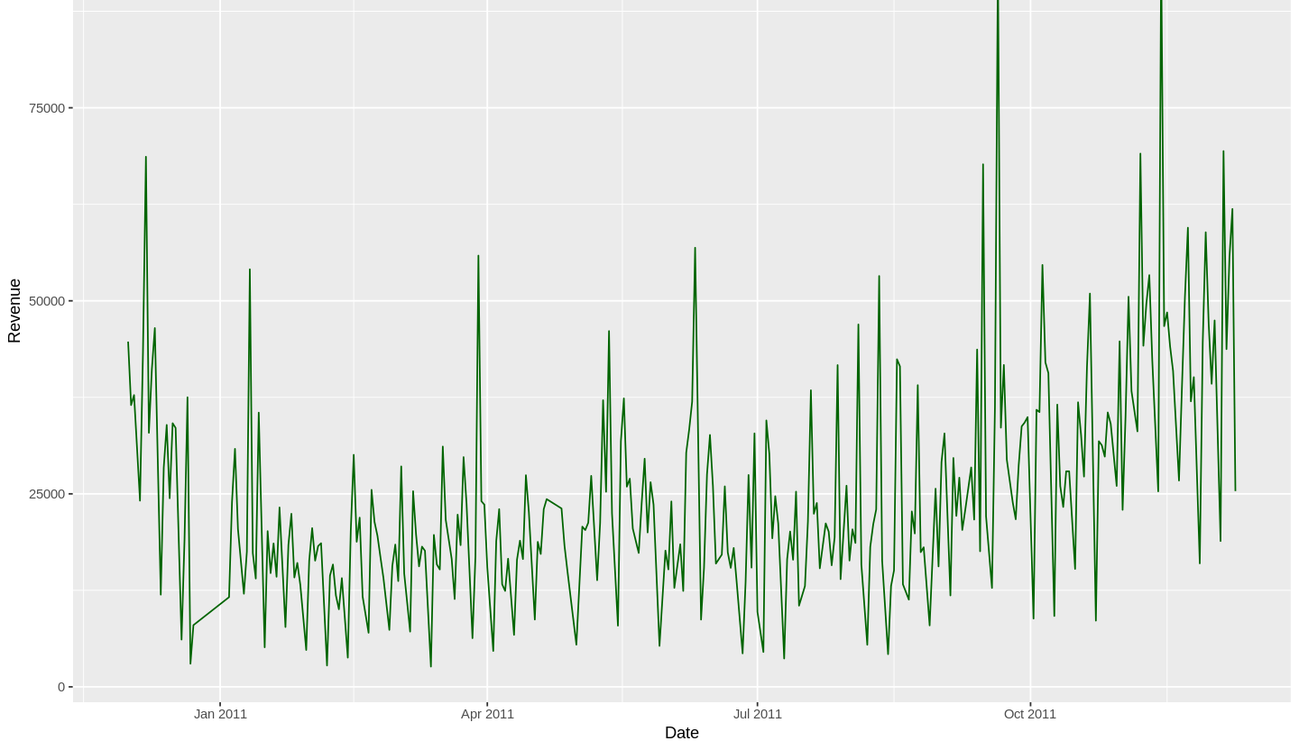
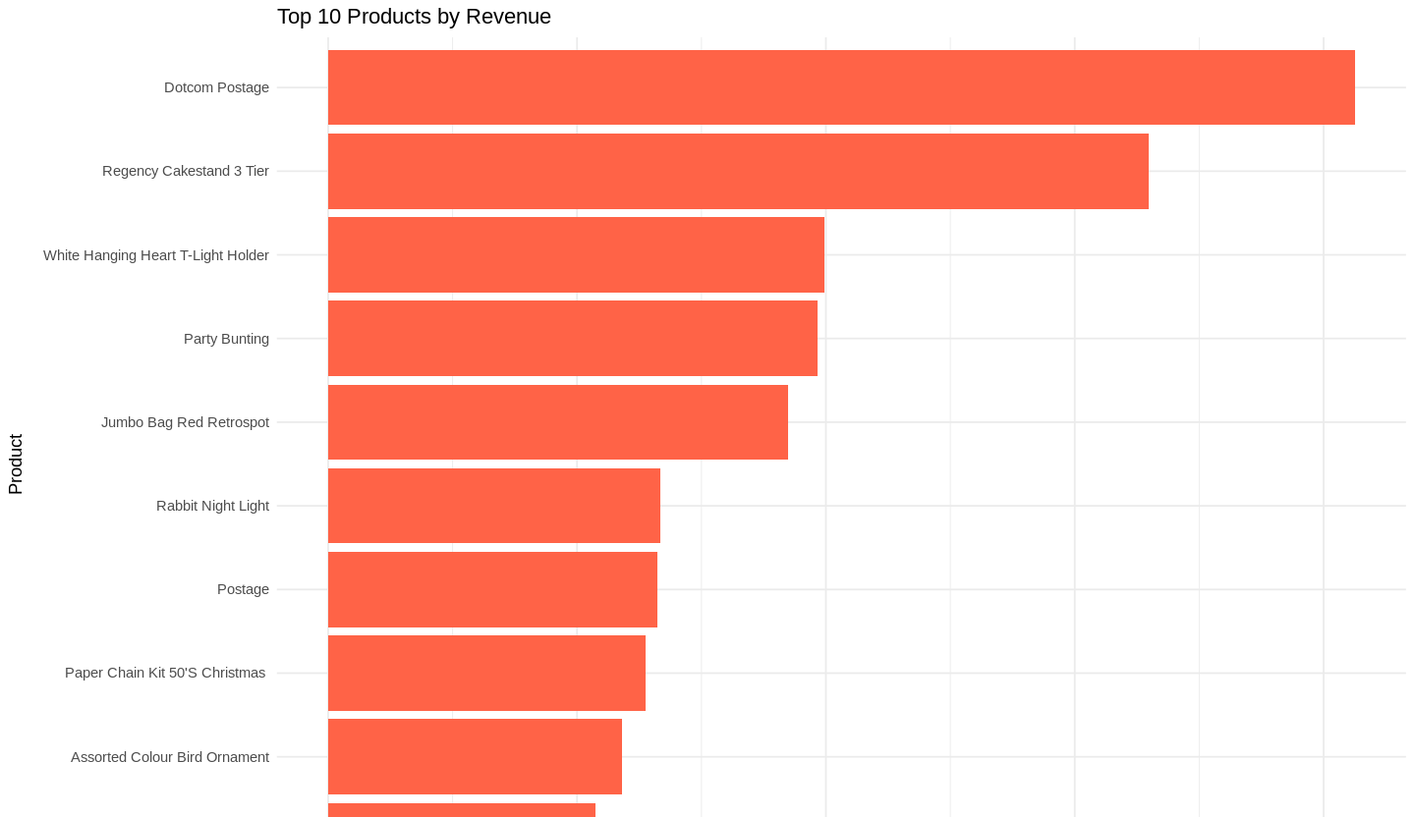
Here we are showing the revenue over time around 2011, there is no particular trend or seasonality, even though in the last period revenue is increasing. We have a few pecks around September/October. The product which generates the most revenue is Dotcom Postage.

Slide 3
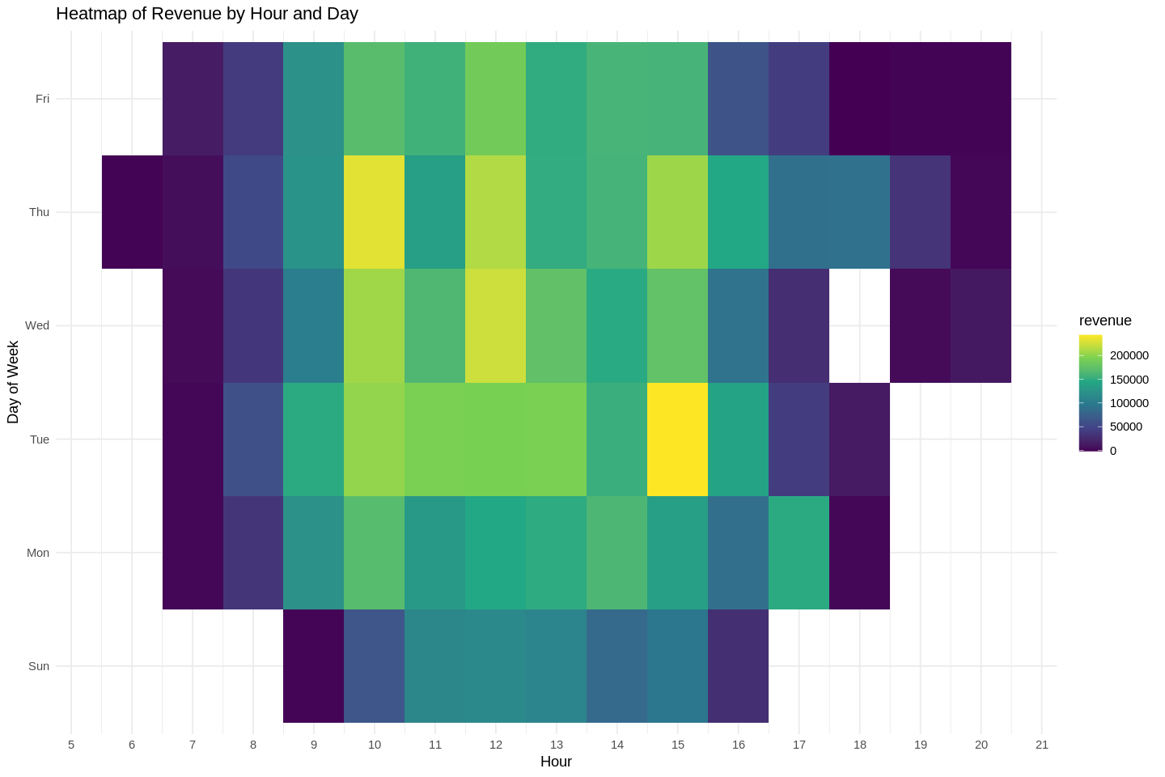
When do people tend to shop online?
We decided to look into the data and try to understand when users do tend to shop online, this could lead to some insightful views and profiling for the marketing team.
As shown through the heatmap, people do tend shop online more on Thursday morning and Monday afternoon. Thursday could be related to the proximity to the weekend.

Slide 4
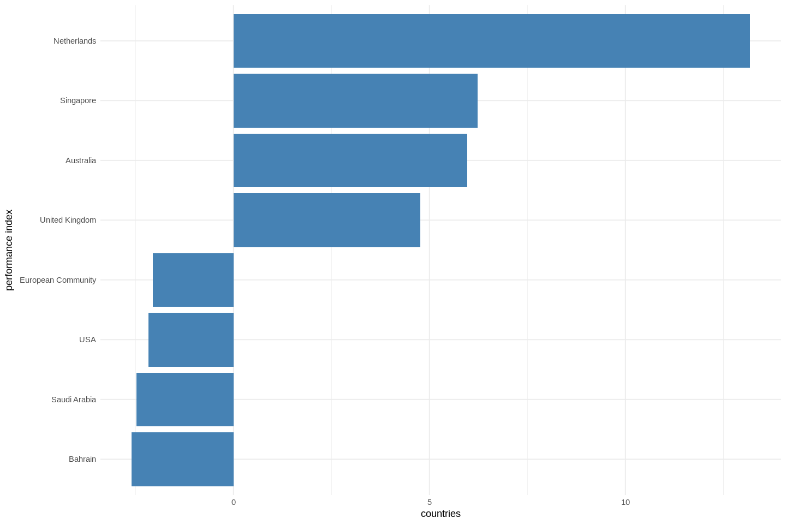
Top and worst performers
KPIs (AOV, ARPU, AIPU and CLV) have been analysed country by country and standardized.
In the graph, we represented the top 4 performers (the Netherlands, Australia, Singapore and the UK) and the worst 4 (European Community, USA, Saudi Arabia, Bahrain).

Slide 5
Insights
Customers behaviour varies significantly State by State.
Three of the top performers (Australia, Singapore and the Netherlands) have considerably high performances, suggesting investments in those countries to enlarge consumers’ base. The United Kingdom performance index, instead, is mostly carried by a good customer lifetime value, even though the other KPIs perform around the average.
The worst performers have high rates of refunds: suggesting that is better to modify the policies in those States.

Slide 6
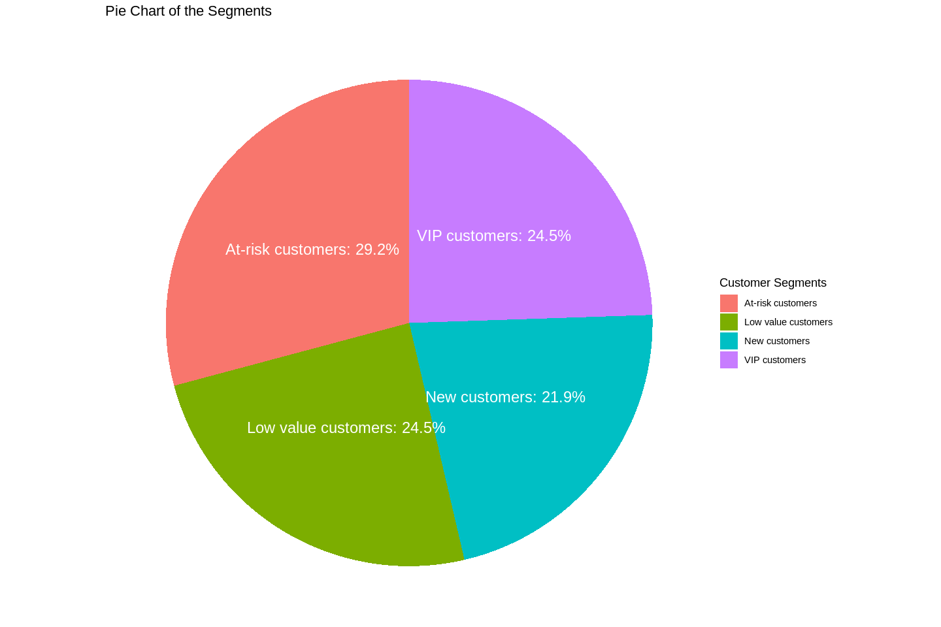
Customer segmentation based on RFM
We identified four segments of customers based on their recency (how recently a consumer made a purchase), frequency (how often they buy) and monetary (how much they spend) and applying clustering techniques.
 | Low value customers | At-risk customers | VIP customers | New customers
Recency | 0.08 | -1.35 | 0.15 | 1.52
Frequency | -1.08 | 1.52 | 0.3 | -1.16
Monetary | -0.90 | 0.65 | 1.08 | -1.10

